Slide 1
Project Group 49:
Chatbox: Jarvis
Prepared by:
YEO JIE KAI 2100771@sit.singaporetech.edu.sg | CHUA JIA ZHE 2102909@sit.singaporetech.edu.sg
YEONG JING KANG 2102090@sit.singaporetech.edu.sg | MARCUS OH HAN YAO 2101738@sit.singaporetech.edu.sg
ZHENG SHITAN 2101290@sit.singaporetech.edu.sg | P8, Group 49
Notes:
Your video should include 3 major sessions: (a) Group number and team members; (b) introduction of the key points on how your program is implemented, such as: overall structure of your system, the implemented system functions, the developed smalltalk features and other extra features if any, the data structure used for knowledge base. (c) a live demonstration of your system from start to all the implemented functions/features.
The video should not exceed 10 minutes;
You may choose the way how the presentation is made, including number of presenters or even no presenter.

Slide 2
TOC
Objective
Overall structure of systems
Chatbot default functions
Implemented system functions
Project cycle stages
Demo

Slide 3
Objective
The aim of this project is to implement a simple chatbot that can respond to simple queries made up of a single question word (called the intent) and an object (called the entity).
The chatbot will be able to answer questions such as
“Where is the printer?”
“What is C?”
by identifying the intent (where or what) and entity (printer or C) then looking up the answer corresponding to this pair in a simple database.

Slide 4
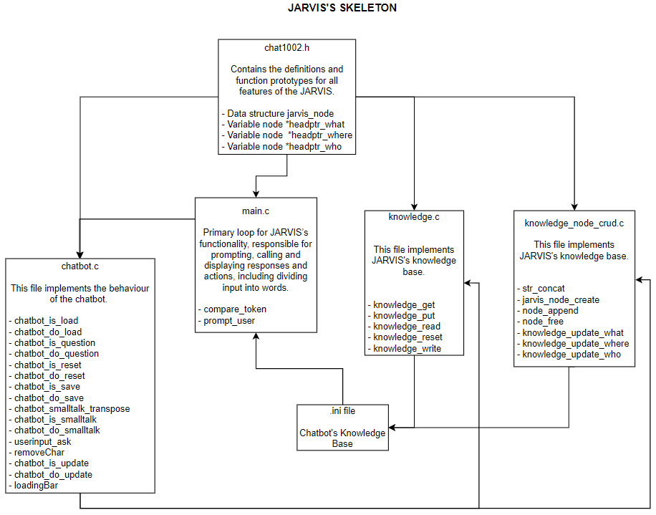
Overall structure of system
START
Notes:
This is a diagram of how JARVIS’s components look like.
Starting from the top, the header file chat1002.h contains all of our defined functions and data structures, used in its other components
Moving down, main.c is the heart of JARVIS’s operations, responsible for calling the appropriate functions to accomplish commands given by users
On the left, chatbot.c is the backbone of JARVIS, containing all the action functions that are called based on the intent given in the commands
The two knowledge files work together to perform CRUD operations on our knowledge base, which is the .ini file below.

Slide 5
Implemented System Functions

Slide 6
Chatbot Default Functions
The table below describes the intents and entities that must be understood by the chatbot.
Instructions | Entity | Description
RESET | - | Reset the chatbot to its initial state.
LOAD | filename | Load entities and responses from filename.
SAVE | filename | Save the known entities and responses to filename.
EXIT | - | Exit the program.
Questions | Entity | Description
WHERE [IS] | any noun phrase | Give the location of the entity.
WHAT [IS] | any noun phrase | Give a definition of the term.
WHO [IS] | name | Describe the person of this name.

Slide 7
Implemented System Functions
Functions | Description
chatbot_is_exit() & chatbot_do_exit() | Checks if the intent is exit, if yes, exits program.
chatbot_is_load() & chatbot_do_load() | Checks if the intent is to load a file, if yes, loads data from a text file into linked list.
chatbot_is_question() & chatbot_do_question() | Checks if the intent is a question, if yes, chatbot will try to answer the questions.
chatbot_is_reset() & chatbot_do_reset() | Checks if the intent is to reset knowledge base, if yes, chatbot will free the memory used for linked list to reset the knowledge base.
chatbot_is_save() & chatbot_do_save() | Checks if the intent is save, if yes, saves knowledge base into text file.
chatbot_is_smalltalk() & chatbot_do_smalltalk() | Checks if the user inputs are small talks, if true, will reply to user with simple responses.
chatbot_is_update() & chatbot_do_update() | Checks if the intent is to update entity of a question intent, if yes, chatbot will let user update an entity of the question intent.

Slide 8
Implemented System Functions
Functions | Description
knowledge_get() | Retrieves response to a question
knowledge_put() | Inserts a response to a question
knowledge_read() | Reads the knowledge base from a file
knowledge_reset() | Erases all of the knowledge
knowledge_write() | Saves the knowledge base in a file

Slide 9
Implemented System Functions
Functions | Description
str_concat() | This function safely concatenates an array of strings.
jarvis_node_create() | This functions create a new node.
node_append() | This functions adds a node to the end of the linked list.
node_free() | This function is to free up all nodes in a linked list. Used to reset the knowledge base.
knowledge_update_what() & knowledge_update_where() & knowledge_update_who() | “What/Where/Who” Linked List: Addes new node to the knowledge base and uses node_append() to add node to their respective linked list.
loadingBar() | This function is to provide a better UI experience for the user, used mainly to show the saving process.

Slide 10
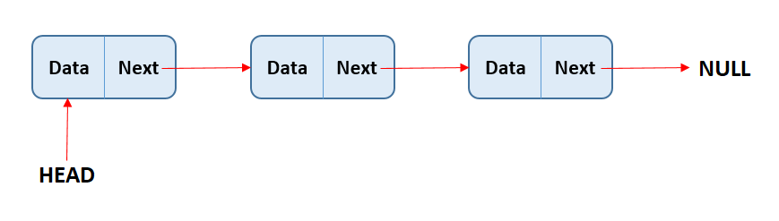

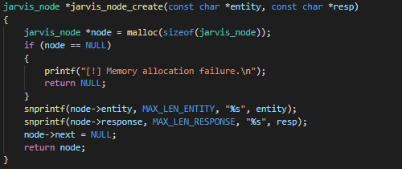
Knowledge_node_crud.c
Node - Create
We will be using linked list to store and string entities together.
Linked lists are often used because of their efficient insertion and deletion. They can be used to implement stacks, queues, and other abstract data types.

Slide 11
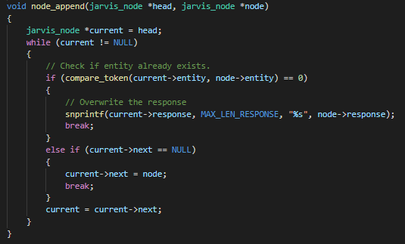
Knowledge_node_crud.c
Node - Append
This function is to be called in the following functions to add nodes to the end of the linked list.

Slide 12

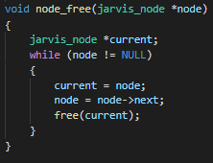
Knowledge_node_crud.c
Node - Free
To reset the chatbot knowledge base,
we simply just release all of the nodes in all of the linked lists by freeing the memory used.

Slide 13

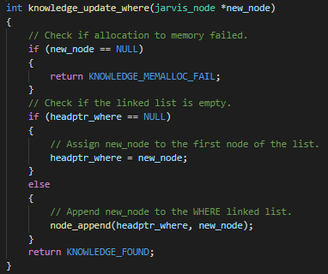
Knowledge_node_crud.c
Entity:
“WHERE/WHAT/WHO”
This function adds a new node to the “where” knowledge base.
If Entity is “Where”, will create a new node and link the node to the “Where” linked list.

Slide 14
Knowledge_node_crud.c
Entity:
“WHERE”
This function adds a new node to the “where” knowledge base.
If Entity is “Where”, will create a new node and link the node to the “Where” linked list.

Slide 15
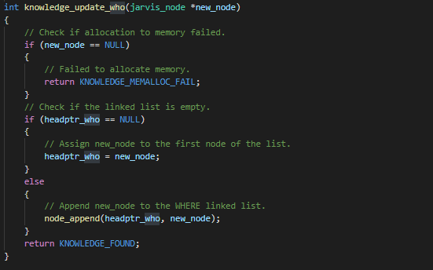
Knowledge_node_crud.c
Entity:
“WHO”
This function adds a new node to the “Who” knowledge base.
If Entity is “Who”, will create a new node and link the node to the “Who” linked list.
Notes:
image is an example. Variables have yet to change. Please update images once variables names have been changed

Slide 16
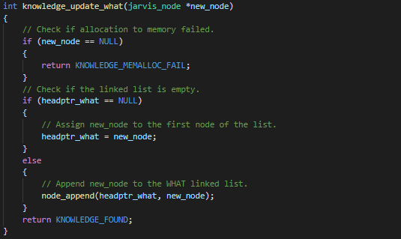
Knowledge_node_crud.c
Entity:
“WHAT”
This function adds a new node to the “What” knowledge base.
If Entity is “What”, will create a new node and link the node to the “What” linked list.
Notes:
image is an example. Variables have yet to change. Please update images once variables names have been changed

Slide 17
Developed small talk features

Slide 18

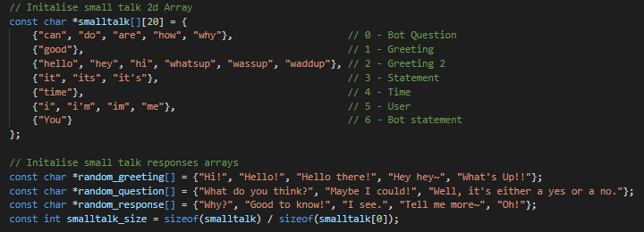
Technical description of:
Developed small talk features
User’s input will be checked with an internal cache of small talk related starting words to determine if it is a small talk intent.
To give JARVIS a more “responsive” and “interactive” feel for the user experience, randomized template responses are implemented.
“You” and “I” are transposed during the conversation between the user and JARVIS. (If ‘you’, then ‘I’ and vice versa)
Notes:
To determine if the intent of a user’s input is chat related, the first word of the input is checked against an internal cache of known smalltalk related starting words. The cache is a constructed 2D array, to sort and categorize the different possible smalltalk keywords based on similarity.
input is then processed through the perspective transposer function. The input entity is checked here for all words that are subject or object pronouns, These include “I”, “I’m”, “Me” or “You”. If they satisfy these criteria, they are transposed / replaced with a word of the opposite meaning, like “You” into “I”.
There are also additional lists consisting of template responses, to input such as smalltalk questions etc. The final response is constructed based on initial intent keyword, where different intent categories illicit different randomized template responses, to give JARVIS a more “responsive” and “interactive” feel. There is also a special intent keyword, “time”, where the system time is extracted and displayed as a response to the user.

Slide 19
Extra Features

Slide 20
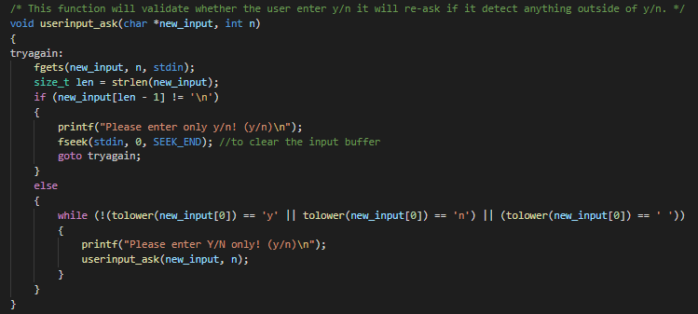
Technical description of:
Error handling features:
Y/N checker
This function will receive the user’s input when the program requires a Y/N response from the user.
This function will check and reject any responses that are not “Y” or “N” (not case sensitive) and ask the user for the correct input.
To prevent fget() buffer overflow, fseek is implemented after the fget() to clear input buffer.

Slide 21
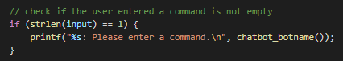
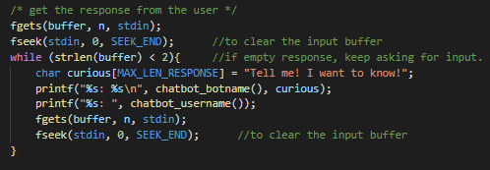
Technical description of:
Error handling features:
NULL inputs
This function will check for any empty/null inputs by the user and prompt the user to enter their commands/answers/responses.

Slide 22
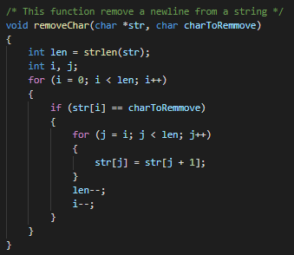
Technical description of:
Error handling features:
Remove trailing newline (\n)
This function will remove any newline (\n) inputs captured by the system. It is important to remove newline characters to prevent the program from calling the newline action when retrieving the value.

Slide 23
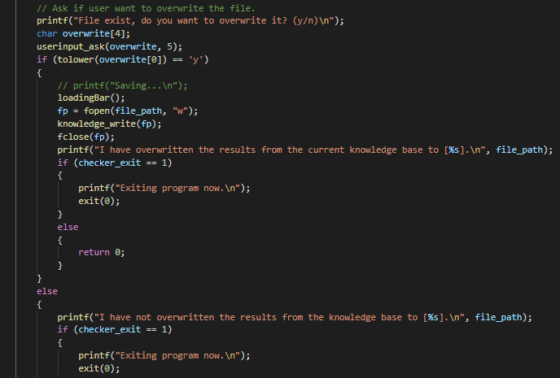
Technical description of:
Error handling features:
Overwriting (save) checker
This function will check for any existing file name that the user is trying to save to that already exists.
If exists, proceeds to prompt user if user wants to overwrite. (Y/N)

Slide 24
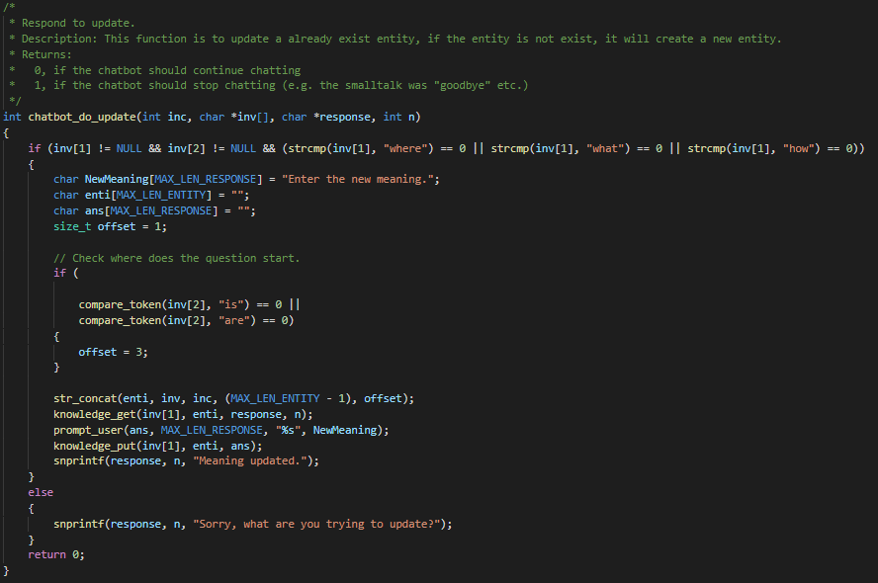
Technical description of:
Error handling features:
Updating entity
When the bot is unsure of an entity of an intent, the bot will prompt the user for an answer.
However, if the user has entered an inaccurate entity and wishes to change it, this function allows the user to update/change/replace the entity of the intent.

Slide 25
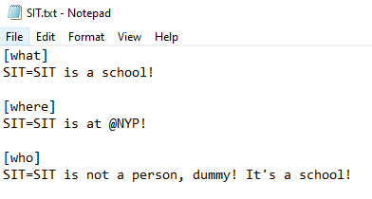
File Format
INI file
An INI file is a text file divided into sections, with each section containing a series of key-value pairs written one per line.
Keys (properties)
Name = value
Sections
[section]
a=a
b=b

Slide 26
Project cycle stages
04
Questions & Answers
Prototyping
Obtaining skeleton program.
If intent is a question, check for answers in the knowledge using knowledge_get and return response or ask for answers.
01
03
Chatbot small talks
Additional functions & Error handling
Implemented chatbot_is_smalltalk() and chatbot_do_smalltalk() so that chatbot understands small talks.
Chatbot does reset, saving and loading of files along with error handling of user inputs.
02
Notes:
Elaborate on how each stage.

Slide 27
DEMO
Chatbot: Jarvis

Slide 28
Thank you!

Slide 29
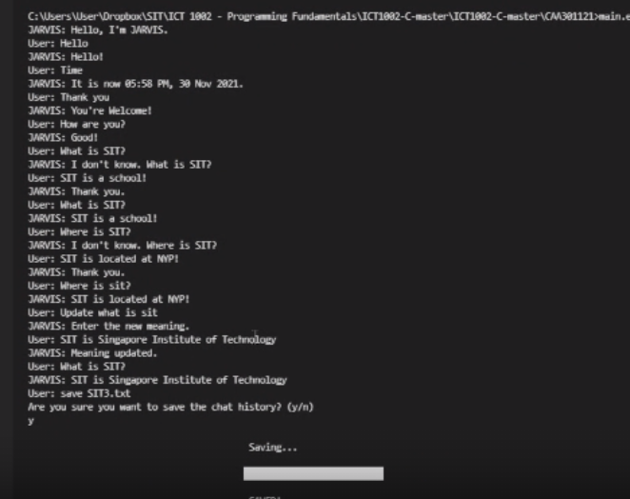
program start
> ask smalltalk (time or two options) ← smalltalk done
> ask a question (what is SIT?) ← question done
> give response ← knowledge_get done
> ask same question (what is SIT?)
> ask another question (where is SIT?)
> give response
> update question answer (where is SIT?) ← update done
> save <filename> ← save done
Notes:
Hello
Time
Thank you
How are you? ← smalltalk done
What is SIT? ← question done
SIT is a school!
What is SIT?
Where is SIT? ← knowledge_put/get/ done
SIT is located at NYP!
Where is SIT?
load SIT.txt ← load done knowledge_read/
What is SIT?
Where is SIT?
Update what is SIT ← update
SIT is Singapore Institute of Technology
What is SIT?
Save SIT3.txt ← save knowledge_write?
[Show SIT3.txt]
Reset ← reset
What is SIT?
Exit ← exit
Yyy
{enter}
y
{enter}
SIT2.txt
Y

